Slide 1

Analysis of Asylum Applications and Decisions for Egyptian Refugees & Foreign Refugees in Egypt
6th Grade

Slide 2
Meet our team
Lamiaa Wael
Mariam Ahmad
Michel Nasr
Mohammed Anwar

Slide 3
Table of contents
01
02
03
04
Introduction
Data Overview
Brief overview about the project purpose.
Describe the dataset.
Key Insights
Interactive Report
Briefly explain the analytical approach taken in Power BI.
Integration of technology tools in mathematical exploration.

Slide 4

01
Introduction
Importance of studying asylum applications and decisions.

Slide 5
Introduction
The purpose of this project is to analyze asylum applications and decisions made for refugees originating from Egypt and foreign refugees in Egypt. By examining the data on asylum seekers and the outcomes of their claims, the project aims to identify trends and patterns that can enhance our understanding of the factors influencing asylum processes.
This analysis provides insights into the demographic characteristics of asylum seekers, the countries they are applying to, and the reasons behind their migration, ultimately contributing to a more comprehensive picture of the asylum landscape.

Slide 6
Importance of studying asylum applications
Studying asylum applications and decisions is crucial for several reasons:
Understanding Human Displacement
Promoting Awareness
Enhancing Refugee Support Systems
Facilitating Future Research

Slide 7
Finding appropriate dataset
We searched in different websites like:
Kaggle.com
data.world.com
Data government
Humdata.com
and other, until we found what we want : https://data.world/unhcr/ece55d3e-2c5e-49fd-8ddb-7b9dd3f569e1

Slide 8
Data overwiew
02

Slide 9
Dataset overview
Data collated by UNHCR, containing information about forcibly displaced populations and stateless persons, spanning across almost 70 years of statistical activities. The data includes the countries / territories of asylum and origin. Specific resources are available for end-year population totals, demographics, asylum applications, decisions, and solutions availed by refugees and IDPs (resettlement, naturalization or returns).
Consists of 10 tables, 5 for Egyptian refugees, and 5 for foreign refugees in Egypt.

Slide 10
Overview of the tables
Asylum applications by asylum seekers originating from Egypt
contains data on asylum applications submitted by individuals from Egypt, detailing
the number of applications by year, country of asylum, and procedure type.
Asylum decisions taken on asylum claims of asylum seekers originating from Egypt
Demographics and locations of forcibly displaced persons originating from Egypt
summarizes the decisions made on those applications, including outcomes such as recognition, rejection, and closure.
provides migration statistics from various countries of origin to Egypt, detailing the number of asylum seekers and refugees by gender and age group over several years.

Slide 11
Overview of the tables
End year stock population figures for forcibly displaced persons originating from Egypt
Solutions for refugees and IDPs originating in Egypt
contains records of refugees, internally displaced persons, asylum seekers, and others of concern to UNHCR in Egypt from 1964 to 2015, categorized by country of origin and including notable trends in displacement and asylum requests over the years.
provides information on the resettlement, naturalization, and return of refugees and internally displaced persons (IDPs) from Egypt, detailing their movements across various countries over several years.
For the 5 foreign refugees sheets it’s the same description.

Slide 12
03
Key Insights

Slide 13
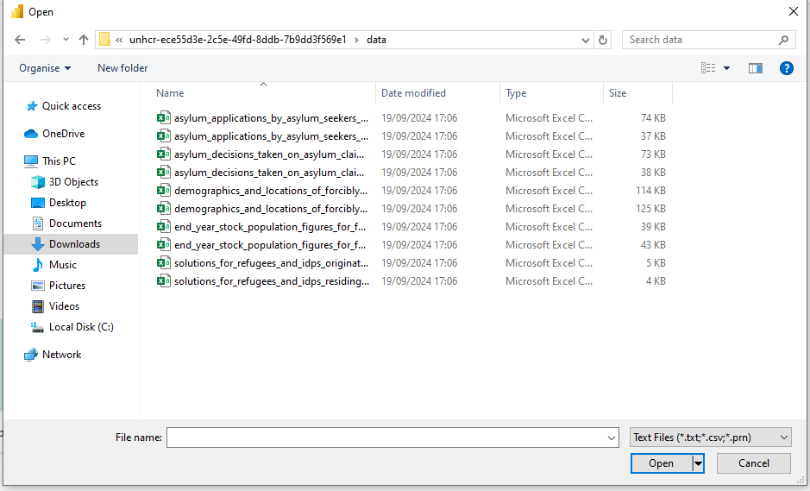
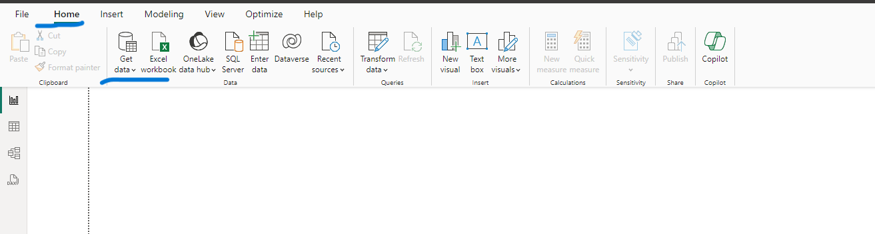
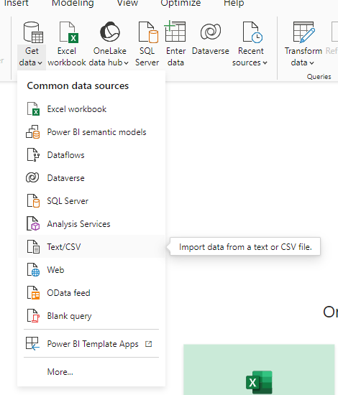
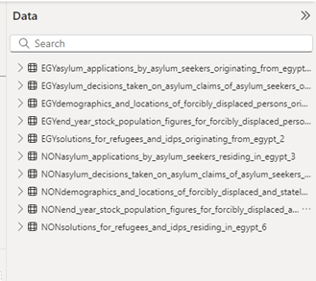

Outline the Project Steps
Step 1
Step 2
Step 3
Open Power BI and from Home, Click Get Data
Import files that we need
From get data choose Text/CV
Step 4
It will show like this after importing. We renamed it to identify datasets for Egyptian and foreign refugees in Egypt.

Slide 14
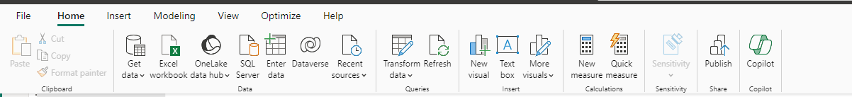
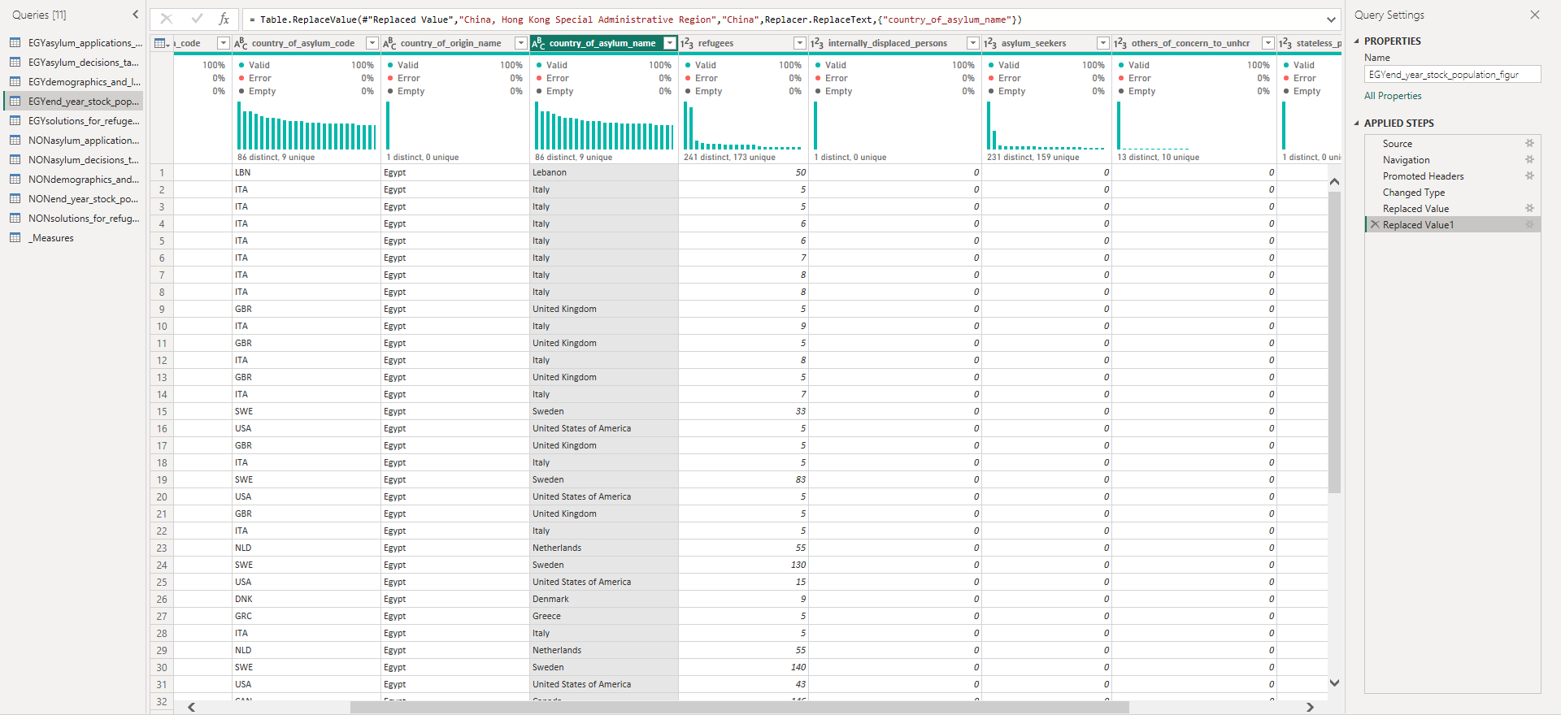
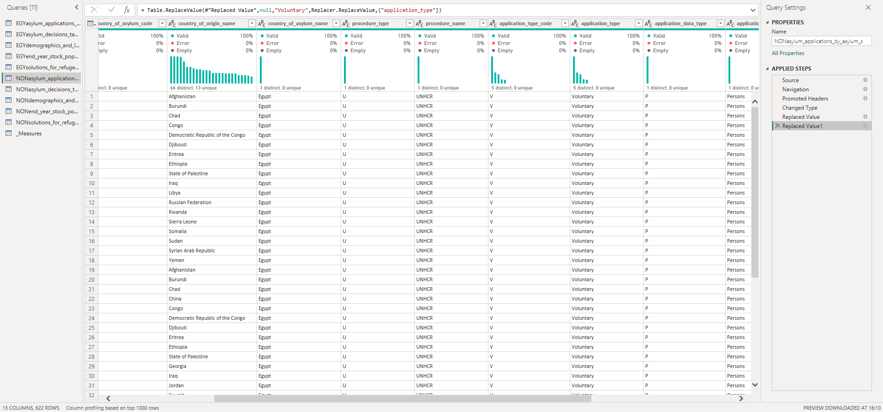
Step 5
Step 6
After importing the datasets go to Home and choose Transform data
EGY end-year stock population
NONasylum applications by asylum seekers residing in Egypt
After clicking on Transform data it will open Power Query and check if datasets are cleaned or not in the table: EGY end-year stock population at column Country of asylum name we replace values (“ United Kingdom of Great Britain Northern Ireland” to “United Kingdom”) and (“Hong Kong special administration” to “China”), in the table: NONasylum applications by asylum seekers residing in Egypt at column Country of origin name we replace null values to “Unknown” and column Application type we replace null values to “Voluntary”

Slide 15
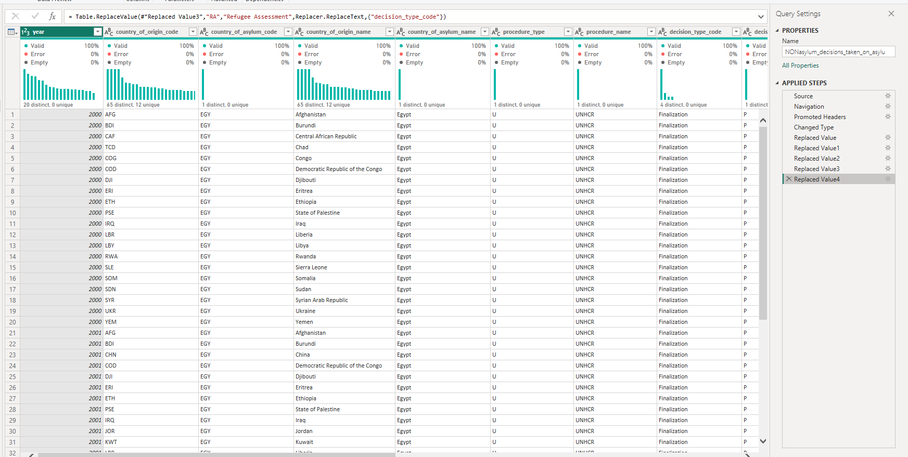
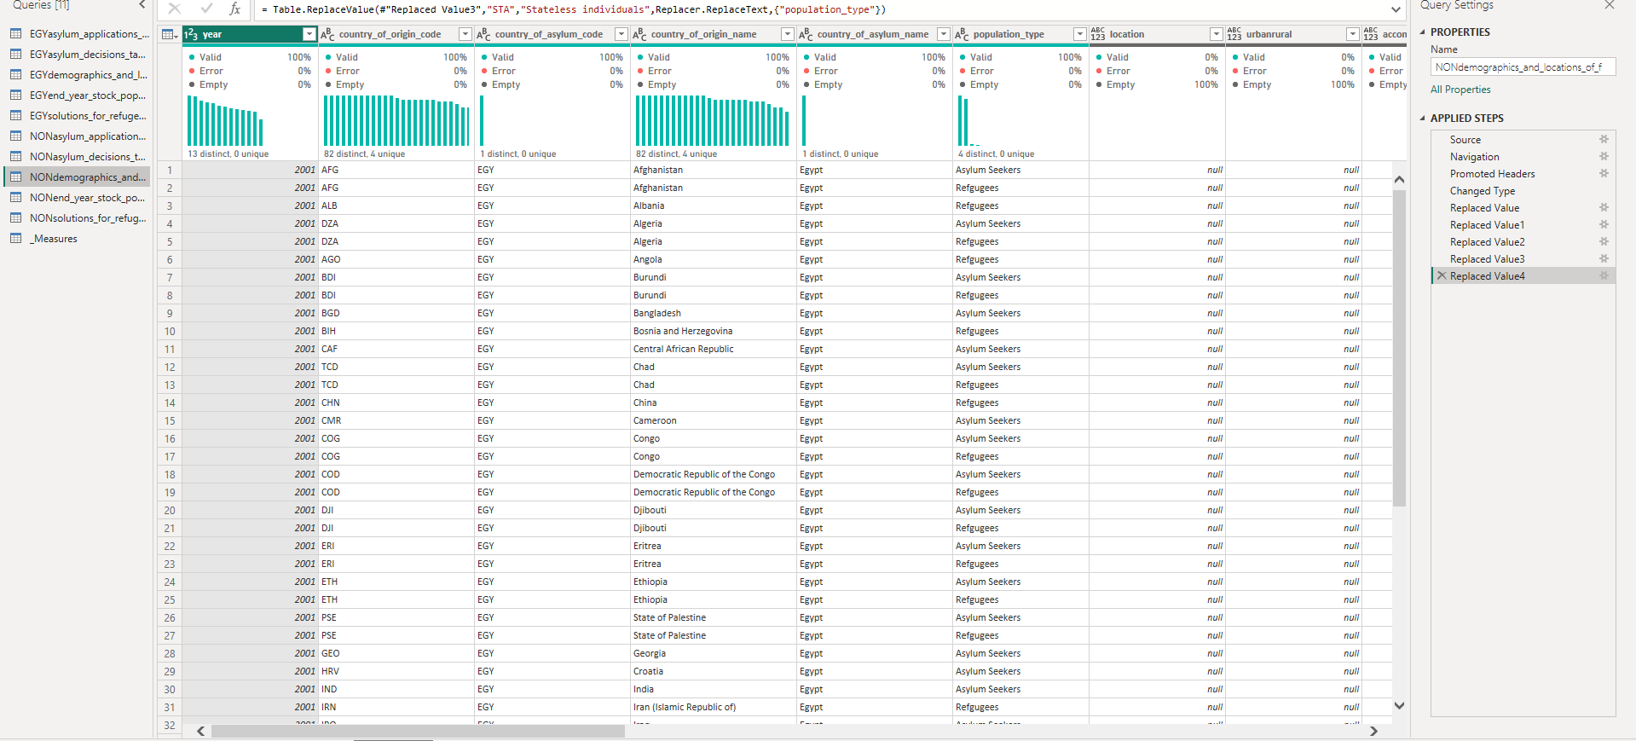
NONasylum decisions taken on asylum claims of asylum seekers residing in Egypt
NONdemographics and locations of forcibly displaced and stateless persons residing
Continue cleaning the dataset in the table: NONasylum decisions taken on asylum claims of asylum seekers residing in Egypt at column Country of origin name we replace null values to “Unknown” and column Decision type code we replace these values (“FI, FA, AR, RA” to “Finalization, Field Adjudication, Asylum Request, Refugee Assessment”) respectively, in the table: NONdemographics and locations of forcibly displaced and stateless persons residing at column Country of origin name we replace null values to “Unknown” and column Population type we replace these values (“ASY, REF, RET, STA” to “Asylum Seekers, Refugees, Returnees, Stateless Individuals”) respectively

Slide 16
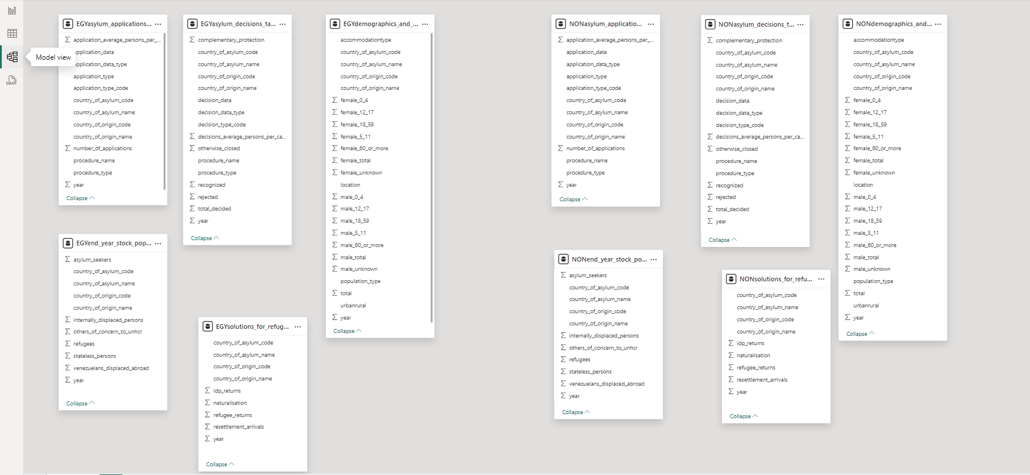
Step 7
Step 8
After cleaning the dataset and checking that it’s ready to visualize an accurate dashboard from Power Query go Home, click Close&Apply
After applying the changes on the left side go to Model view and see if there are any relationships. These relationships are crucial for making data models work efficiently, particularly with multiple tables.
Unfortunately, we don’t have any relationships. Without relationships in Power BI, data from different tables cannot be connected, limiting the ability to perform cross-table analysis or filtering. You would need manual workarounds, which complicates the model and increases the risk of errors. Key functions like DAX won't work as intended, leading to incorrect calculations. Additionally, reports will lack interactivity, suffer from performance issues, and may have data inconsistencies, making relationships essential for accurate, efficient, and dynamic reporting. We searched for a solution to make relationships till we found something called Bridge Table

Slide 17
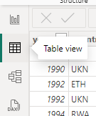
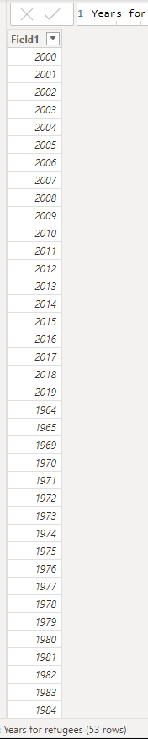
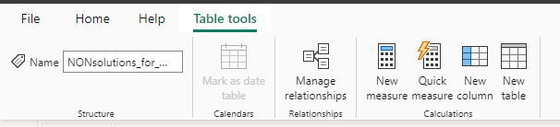
A bridge table in Power BI is an intermediary table used to resolve many-to-many relationships between two tables, allowing for accurate data connections and analysis.
We go to Table View and from Table tools we choose New Table it will allow us to write the DAX formulas. This DAX code creates a calculated table called Years for Refugees that contains a distinct list of years from five different tables by using a combination of functions:
1. UNION: Combines the results from multiple tables into one single table.
2. SELECT COLUMNS: Extract the year column from each table and rename it to "Field1" for consistency across all tables.
3. DISTINCT: Ensures that unique years are included in the final result, removing any duplicates across the different tables.
- It pulls the year column from five separate tables as mentioned in the image Then, it unifies the data into a single column using UNION and ensures only distinct values remain using DISTINCT.
The final result is a unique list of all years across these five datasets related to refugees, stored in a newly calculated table.

Slide 18
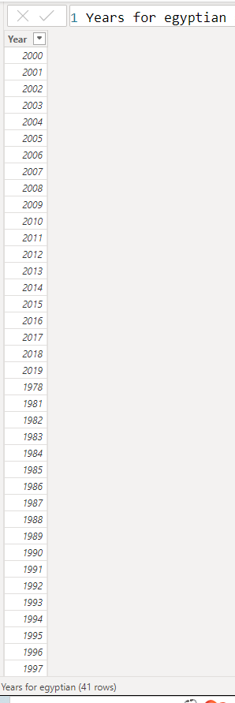
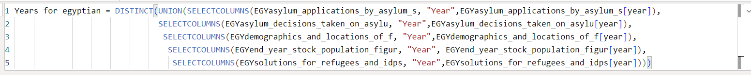
This DAX code defines a calculated table called Years for Egyptian, which contains a distinct list of years pulled from five different tables related to Egypt. It uses the UNION, SELECT COLUMNS, and DISTINCT functions to achieve this. Here's a detailed explanation:
1. UNION: Combines the year data from five different tables into one.
2. SELECT COLUMNS: Extract the year column from each table and rename it as "Year" for consistency across all the tables.
3. DISTINCT: Ensures that unique years are retained after combining the data from all tables.
Step-by-Step:
- It retrieves the year column from five separate tables as mentioned in the image
- These columns are then combined into one table using the UNION function.
- Finally, DISTINCT ensures the result only includes unique year values across all the datasets.
The outcome is a table that contains a unique list of all years from these five datasets concerning Egyptians.

Slide 19
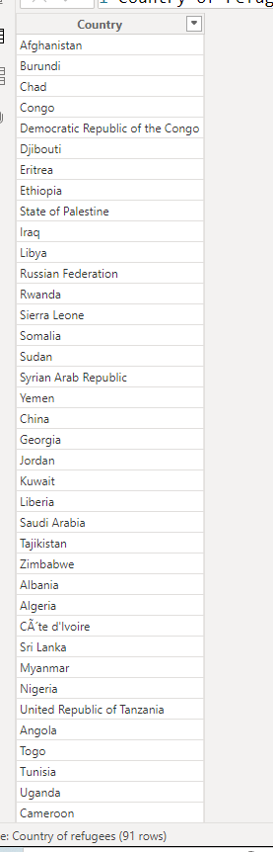
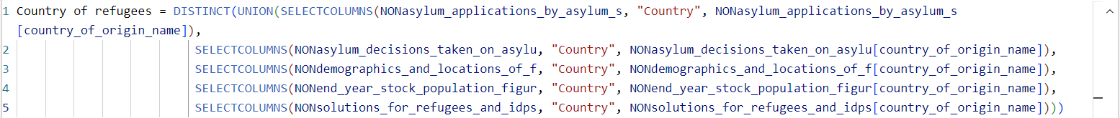
This DAX code creates a calculated table named Country of Refugees, which provides a distinct list of countries based on the country of origin name field from five different tables. It uses the UNION, SELECT COLUMNS, and DISTINCT functions to achieve this. Here’s how it works:
1. UNION: Combines the country of origin name field from the five different tables into a single table.
2. SELECT COLUMNS: Extract the country of origin name field from each table and rename it as "Country" to ensure consistency across all the tables.
3. DISTINCT: Filters out duplicate country names to retain unique entries.
Explanation of Steps:
- The country of origin name field is extracted from five tables as mentioned in the image
- The UNION function consolidates these columns into a single dataset.
- The DISTINCT function removes any duplicate country names, ensuring the final table only contains unique country names.
The result is a distinct list of countries related to refugees, gathered from multiple datasets.

Slide 20
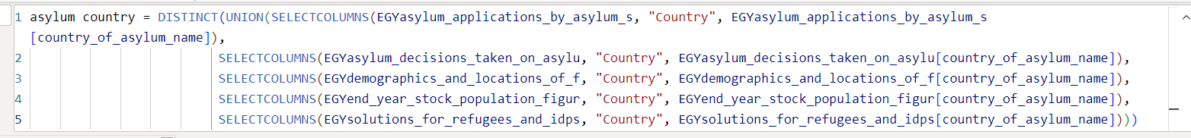
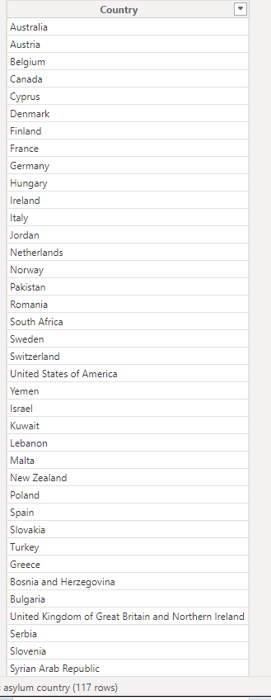
This DAX code creates a calculated table called asylum country, which generates a distinct list of asylum countries by extracting data from five different tables related to Egypt. Here's how the code works:
1. UNION: Combines the country of asylum name column from five different tables into one unified dataset.
2. SELECT COLUMNS: Extract the country of asylum name field from each table and rename it as "Country" to ensure consistency across all tables.
3. DISTINCT: Ensures that unique asylum country names are included in the final result, eliminating duplicates.
Step-by-Step:
The country of asylum name is extracted from the following five tables as mentioned in the image
- The UNION function combines the country columns from these tables into one list.
- DISTINCT removes any duplicate asylum country names, ensuring a unique list of asylum countries.
The result is a unique list of asylum countries gathered from these five datasets related to Egypt.

Slide 21
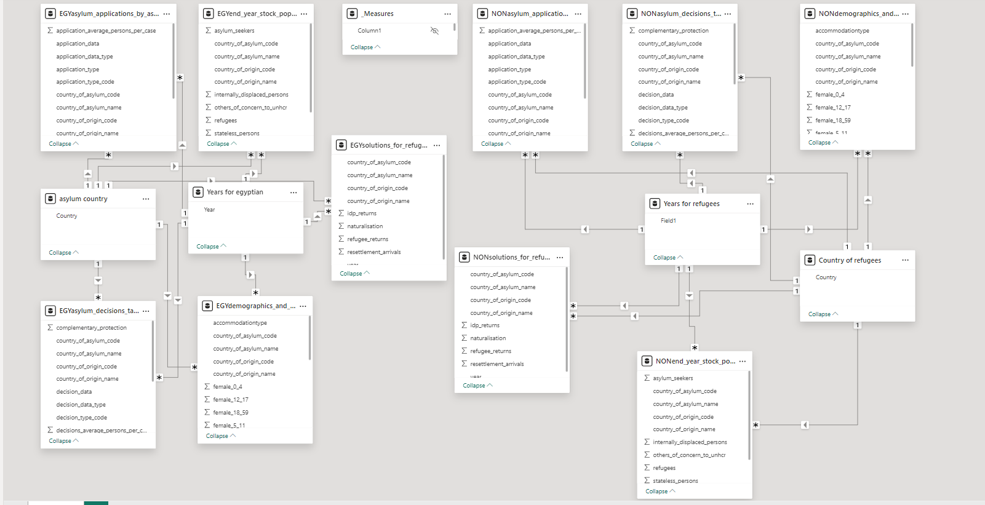
Now after adding these bridge tables for making relationships between tables, this is the result. Two bridge tables for Egyptian refugees and two bridge tables for Foreign Refugees

Slide 22
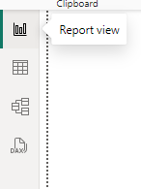
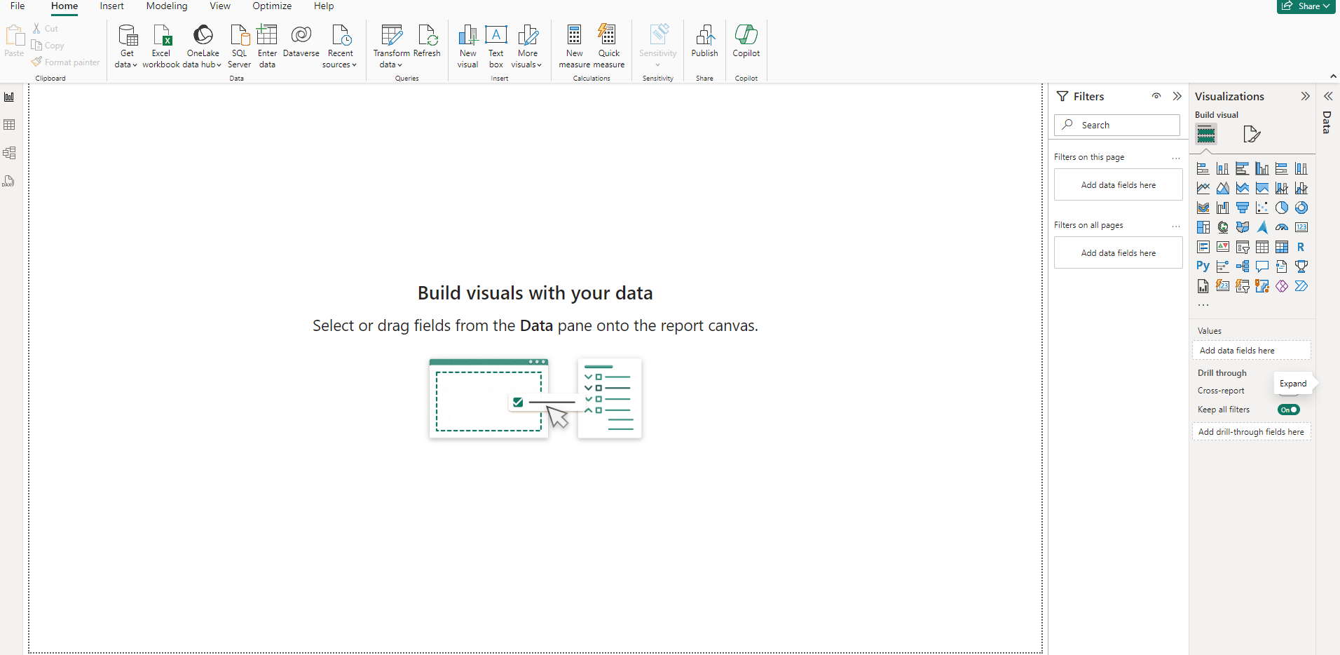
Finally, the last step is Report View. It’s time to make a report or dynamic dashboard

Slide 23

We choose a canvas background to express about dataset “UNCHR” and divided it into two dashboards as you see in the image’s first navigator “Egyptians Refugees Dashboard” while the second is the “Foreign Refugees in Egypt Dashboard”

Slide 24
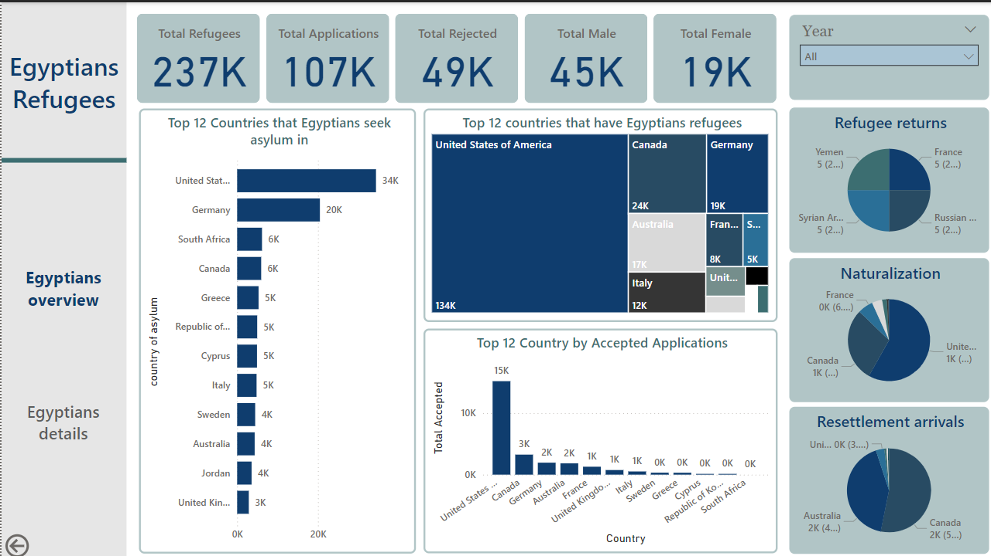
When we click on the first navigator “Egyptians Refugees Dashboard” we see on the left another navigator “Egyptian Overview” The dashboard we provided focuses on Egyptian Refugees and provides insights into various aspects of their refugee status, applications, and related statistics.

Slide 25
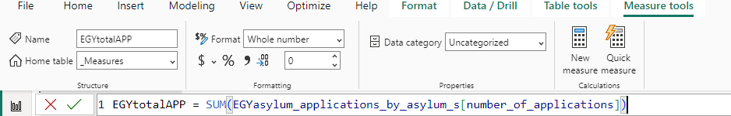
As you see each measure Dax code calculates columns we need to show we used Sum function.

Slide 26
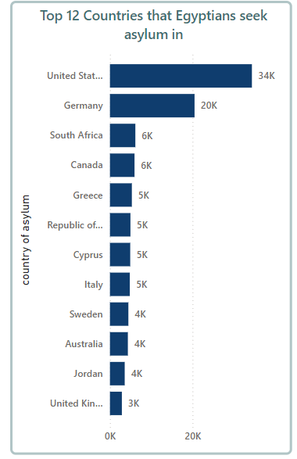
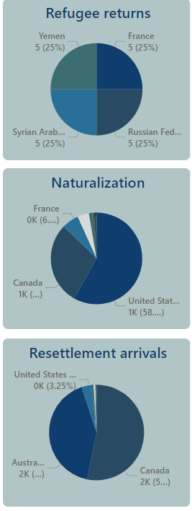
Refugee Returns (Pie Chart)
Yemen, France, the Syrian Arab Republic, and the Russian Federation each account for 25% of refugee returns, indicating Egyptians returning to these countries.
Naturalization (Pie Chart)
The United States leads with 58% of naturalizations for Egyptian refugees.
Canada has 1% of naturalizations, with smaller contributions from other countries such as France.
Resettlement Arrivals (Pie Chart)
The United States (3.25%) and Canada are leading resettlement destinations, along with Australia for Egyptian refugees.
Top 12 Countries that Egyptians Seek Asylum In (Bar Chart)
The United States is the top country where Egyptians seek asylum (34K).
Germany follows with 20K asylum applications.
Other significant countries include South Africa, Canada, and Greece, with applications between 5K and 6K. This chart has a filter on it to show the top 12 countries where Egyptians seek asylum.

Slide 27
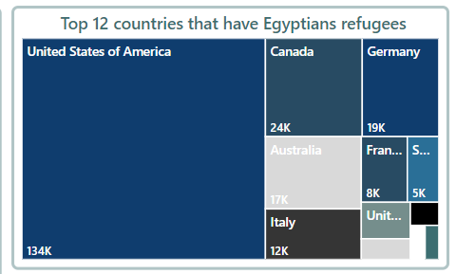
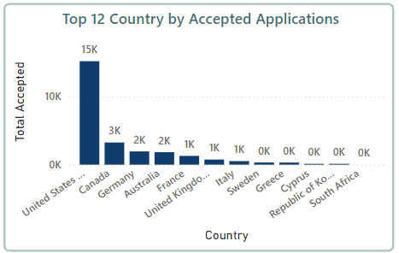
Top 12 Countries by Accepted Application Numbers (Bar Chart)
Similar to the asylum-seeking chart, the United States (15K) and Canada (3K) are the top countries where Applications is accepted.
Other notable countries include Germany (2K) and Australia (2K).
Top 12 Countries Hosting Egyptian Refugees (TreeMap)
The United States is also the leading host with 134K Egyptian refugees.
Other major countries include Canada (24K), Germany (19K), and Australia (17K).

Slide 28
Key Insights :
Migration Patterns: The United States and Germany are major destinations for Egyptian asylum seekers, both in terms of applications and the number of refugees hosted.
Gender Disparity: There are significantly more male refugees (45K) than female refugees (19K).
Refugee Flow: Egyptian refugees are not only seeking asylum but are also involved in resettlement and naturalization, primarily in the US and Canada.
Rejected Applications: With nearly 50% of total applications rejected, this highlights the difficulties Egyptians face in securing asylum in foreign countries.
Returns and Resettlement: There's a notable amount of Egyptians returning to countries like Yemen and France, while the US and Canada are key players in resettling Egyptian refugees.
This dashboard effectively visualizes the asylum and refugee trends for Egyptians, providing a comprehensive overview of where they seek asylum, where they are hosted, and the outcomes of their applications and resettlement processes.

Slide 29
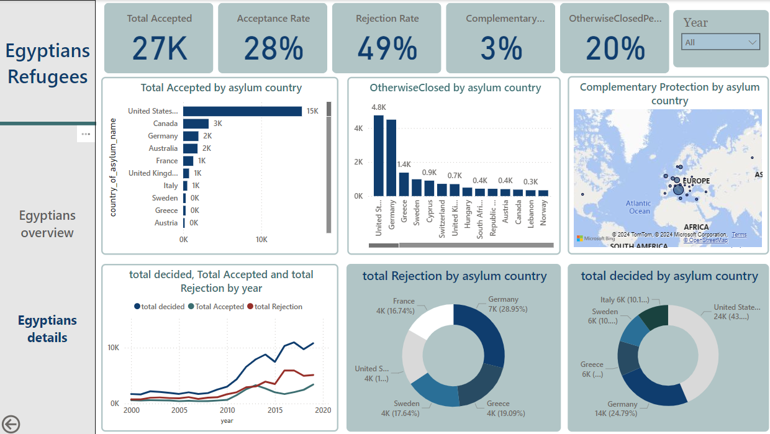
After showing “Egyptian Overview” with key concepts and insights we will click on the next navigator “Egyptians details” This dashboard provides a detailed overview of Egyptian refugees and asylum seekers across different countries, focusing on key metrics like recognition, rejection, and protection rates

Slide 30
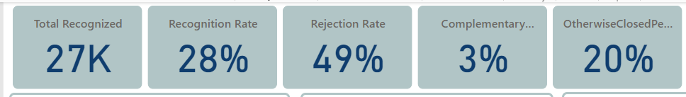
Key Concepts :
Key Metrics (Top Section)
Total Recognized: 27K applications have been accepted.
Recognition Rate: 28% of Egyptian asylum applications are approved.
Rejection Rate: 49% Nearly half of all Egyptian asylum applications are rejected.
Complementary Protection Rate: 3% A small percentage of applicants receive complementary protection.
Otherwise Closed Percentage: 20% represents cases that are neither approved nor rejected but closed for other reasons.
These calculations are done by measures at the DAX formula we will show in the next slide

Slide 31
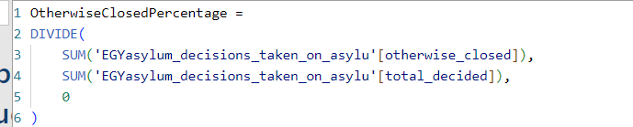
As you see each measure Dax code calculates columns we need to show we used the Divide & Sum functions.

Slide 32
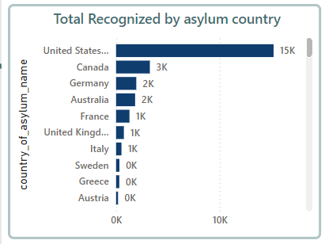
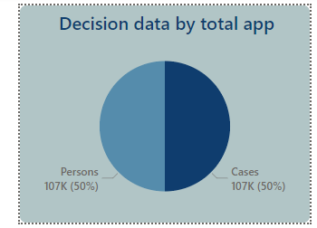
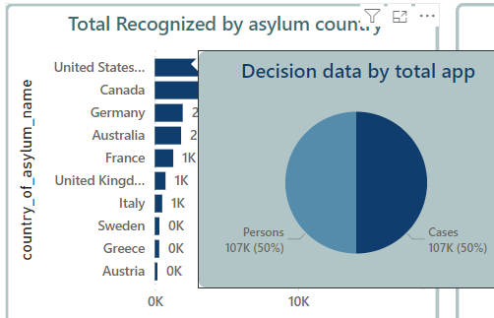
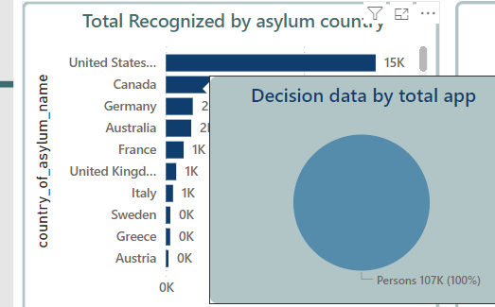
Total Recognized by Asylum Country (Bar Chart)
United States: 15K recognized applications, the highest by far.
Canada, Germany, Australia, France, United Kingdom: Between 1K and 3K recognized applicants.
Decision data by Total app(Pie Chart Tooltip)
Persons: 107K, person decision data, the half of decisions.
Cases: 107k, cases decision data, the other half.

Slide 33
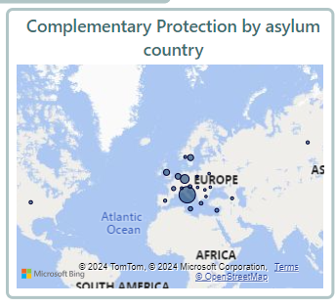
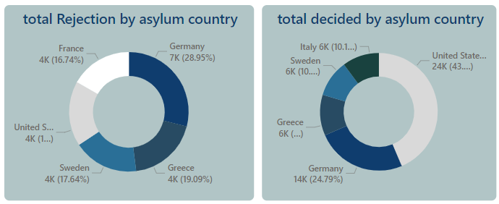
Total Rejection by Asylum Country (Donut Chart)
Germany: 7K rejected applications (14%).
Greece, Sweden, United States: Other significant contributors, each with 4K rejected cases.
Total Decided by Asylum Country (Donut Chart)
United States: 24% of total cases (24K decisions).
Germany: 14% of total cases (14K decisions).
Italy, Greece, United Kingdom, etc.: Smaller percentages of total decisions.
Complementary Protection by Asylum Country (Map)
European countries seem to be the main providers of complementary protection.

Slide 34
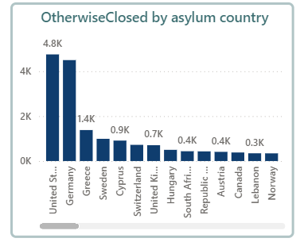
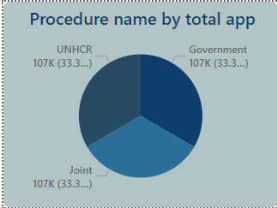
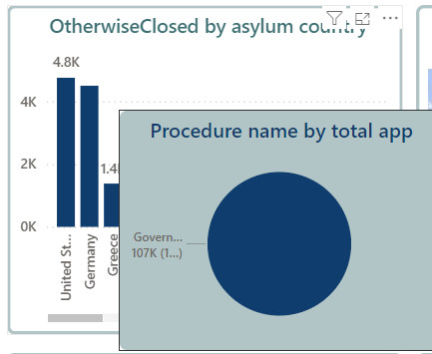
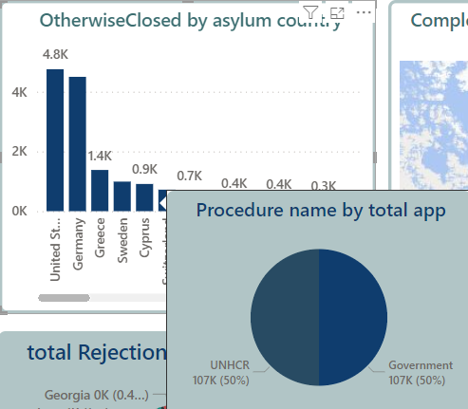
Otherwise Closed by Asylum Country (Bar Chart)
United States: 4.8K closed cases, the most.
Germany, Greece, and Sweden: Also significant contributors to otherwise closed cases, though lower than the U.S.
Procedure name by Total app(Pie Chart Tooltip)
indicates that the three categories (UNHCR, Government, and Joint) each represent the same number of applications: 107K, which constitutes 33.3% of the total for each category.

Slide 35
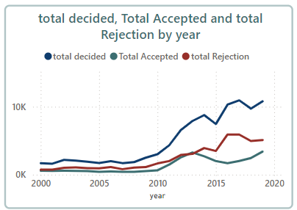
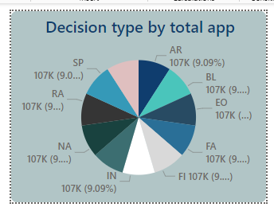
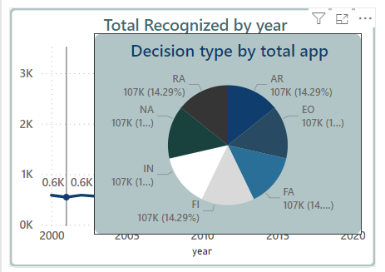
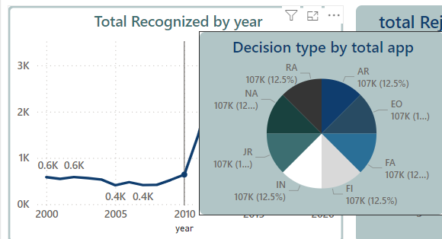
Decision type by Total app(Pie Chart Tooltip)
Each type contributes equally to the total, as all sections represent 9.09% of the total number of applications, with 107K applications for each decision type. This chart provides a clear, evenly distributed comparison of the different decision types.
Total decided, accepted and Rejected by Year (Line Chart)
Spike in 2013: Around 3.5K recognized this year.
Recognition declines after this peak, reaching about 1.7K in 2020.
This chart shows the trend of recognition over the years, with a notable spike in 2013.

Slide 36
Key Insights :
This dashboard reveals that the United States plays a dominant role in accepting Egyptian refugees, while Germany leads in rejections. There was a notable peak in recognition around 2013, possibly tied to political or social events. Other countries like Canada, Australia, and France contribute more moderately. The rejection rate (49%) is significantly higher than the acceptance rate (28%), indicating a challenging asylum process. The sharp increase in recognitions around 2013 suggests an impactful event during this period. The otherwise closed rate (20%) further implies administrative or procedural issues, while the complementary protection rate remains negligible (3%).

Slide 37
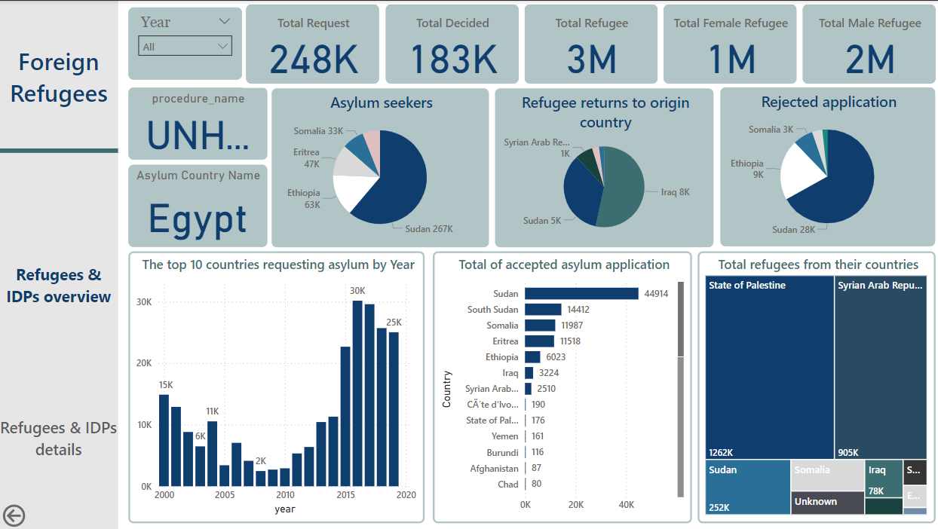
When we click on the second navigator “Foreign Refugees Dashboard” we see on the left another navigator “Refugees & IDPs Overview” The dashboard presents an overview of refugees and asylum seekers, with a focus on UNHCR operations in Egypt.

Slide 38
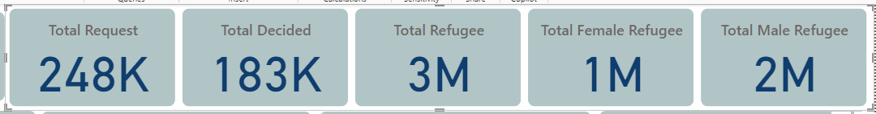
Key Concepts :
Key Metrics (Top Section)
Total Requests: 248K the total number of asylum requests made by individuals in various countries, showcasing the scale of the asylum-seeking process globally.
Total Decisions Made: 183K requests have been processed, whether they were accepted or rejected.
Total Refugees: 3 million (with 1 million female and 2 million male refugees).
These calculations are done by measures at the DAX formula we will show in the next slide

Slide 39
As you see each measure Dax code calculates columns we need to show we used the Sum function.

Slide 40
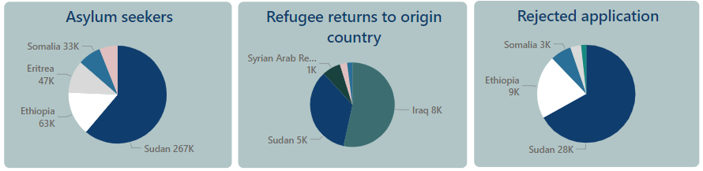
Asylum Seekers by Country(Pie Chart):
Sudan: The largest group (267K).
Ethiopia: Second largest (63K).
Eritrea:(47K), Also significant.
Refugee Returns to Origin Country (Pie Chart):
Iraq (8K) and Sudan (5K) have the highest numbers of returnees, with other notable returns
- Rejected Applications (Pie Chart): Sudan: 28K rejections, the highest.
Ethiopia: 9K rejections,
and Somalia (3K).
also significant.

Slide 41
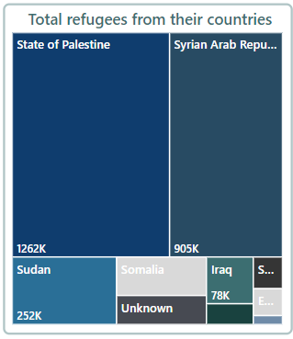
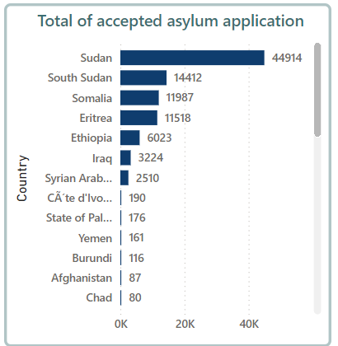
Accepted Asylum Applications by Country (Bar Chart): :
Sudan has the most accepted applications (44K), followed by South Sudan, Somalia, and others.
Total Refugees by Origin Country(tree map):
the State of Palestine: (1,262k),
Syria leads with 905K,
followed by Sudan (252K), and others.

Slide 42


Top 10 Countries Requesting Asylum Over Time (Column Chart):
Requests increased significantly around 2016, peaking at 30K, with a slight decline afterward.
Asylum Requests Over Time (2000-2020)(Column Chart):
After activating Drill Down and Click around 2016, peaking at 30K, with Detailed explanation of total countries requesting asylum by 2016

Slide 43
Key Insights :
The dashboard highlights the scale of refugee and asylum challenges in Egypt, with Sudan being a primary source of asylum requests, accepted applications, and rejections. Syria has the largest refugee population overall, while Sudan has the highest rate of asylum-seeking and acceptance.
This suggests a need for sustained support and policies that address the particular needs of these key countries.
The data reflects a steady increase in asylum applications over the past two decades, with notable refugee populations from neighboring countries like Sudan, Syria, and Somalia.
The high number of rejected applications from Sudan and Ethiopia highlights potential challenges in the asylum process.

Slide 44

When we click on the second navigator “Foreign Refugees Dashboard” we see on the left another navigator “Refugees & IDPs details” This dashboard provides a detailed breakdown of the foreign refugee population in Egypt, focusing on key metrics such as the number of countries involved, the total number of refugees, and the accepted and rejected asylum cases.

Slide 45

Key Concepts :
Key Metrics (Top Section)
Countries: 91
Average age of female: 26
Average age of male: 27
- Accepted Cases: 96K
- Rejected Cases: 43K

Slide 46

Accepted by Country: Sudan has the highest number of accepted refugees, with 45K.South Sudan follows with 14K, while Eritrea and Somalia each have 12K accepted refugees. This indicates Sudan is the largest recipient country for refugees in this dataset.
Otherwise Closed by Country: Sudan also has the highest number of cases classified as "otherwise closed" with 22K.Somalia and Ethiopia follow with 5K and 4K respectively.
Iraq has 3K cases in this category, highlighting that a significant number of refugee cases are closed in these countries.
Complementary Protection by Country: This chart shows small numbers of cases with complementary protection in several countries, with Sudan and Iraq each having some form of protection but the numbers are minimal.South Sudan and Somalia have almost no complementary protection cases.
Refugees by Gender: There are more male refugees (422K) compared to female refugees (339K).This suggests a gender imbalance in the refugee population, with males making up a larger portion.

Slide 47

Refugees by Year: The number of refugees peaked in 2019 at 258K and gradually declined over the next few years. From 2013 to 2016, the numbers remained relatively high, ranging between 214K and 236K.There is a sharp decline after 2016, with the number of refugees falling to 110K in 2017 and continuing to decrease to 88K by 2005.Earlier years, from 1994 and before, show consistently low refugee numbers, typically around 7K
Total Decided, Accepted, and Rejected Applications over Years:
The total number of decisions made on refugee applications shows a fluctuating trend, peaking around 2005 and then again significantly rising between 2015 and 2020, where decisions peaked at 27K in 2020.
The number of accepted applications followed a similar pattern, with peaks at 13K in 2005 and 17K in 2020.

Slide 48
Key Insights :
Sudan plays a significant role both in accepting refugees and in closing cases.
Recent years (2019 and 2020) have seen large numbers of refugees and decisions, with acceptance rates increasing.
There is a notable gender imbalance, with more male refugees compared to female refugees.
Refugee trends have fluctuated, with a major peak in 2019 followed by a decline.

Slide 49
Interactive Report
04

Slide 50


Slide 51

Thanks!
Do you have any questions?

